Slide 1
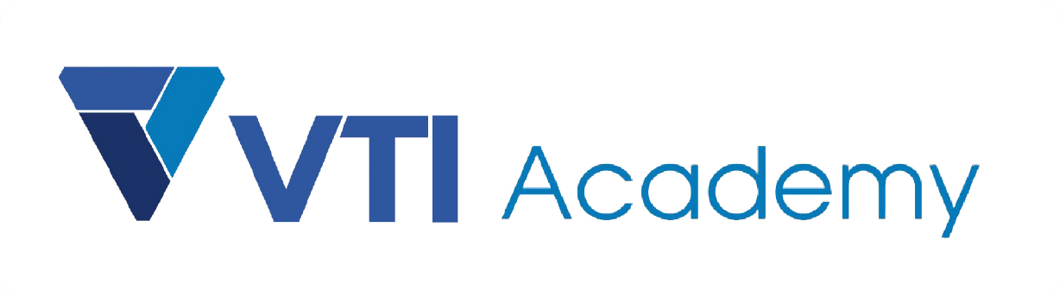
WAY TO ENTERPRISE
AWS
VTI ACADEMY
Author: duy.nguyenngoc1@vti.com.vn

Slide 2
Well-Architected Framework
Well-Architected helps cloud architects build secure, high-performing, resilient, efficient infrastructure for a variety of applications and workloads
Idea
  Stop guessing your capacity needs 🡺 Instead of Auto Scaling Group
  Test systems at production scale
  Automate to make architectural experimentation easier 🡺 Using CloudFormation to deploy in multiple environments to experiments
  Allow for evolutionary architectures (Design based on changing requirements)
  Simulate applications for flash sale days

Slide 3
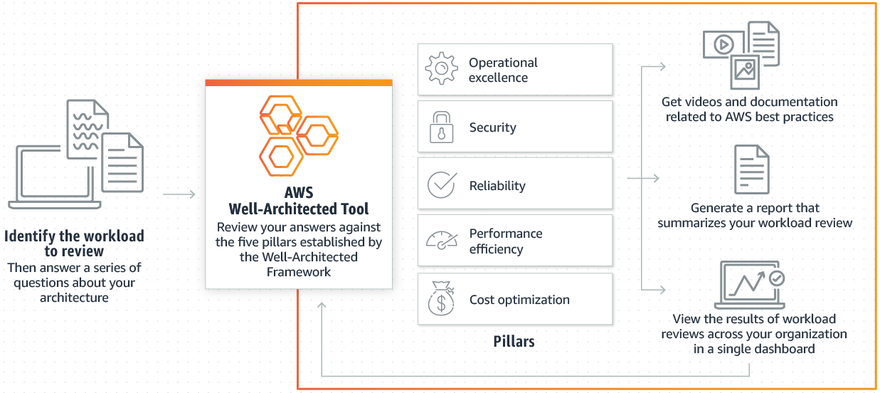
Well-Architected Framework
6 pillars
  Operational excellence
  Security
  Reliability
  Performance efficiency
  Cost optimization
  Sustainability
Tutorial: https://aws.amazon.com/architecture/well-architected

Slide 4
Well-Architected Framework
  Operational excellence
    Includes the ability to run and monitor systems to deliver business value and to continually improve supporting processes and procedures
    Design Principles
      Perform operations as code - Infrastructure as code
      Annotate documentation - Automate the creation of annotated documentation after every build
      Make frequent, small, reversible changes - So that in case of any failure, you can reverse it
      Refine operations procedures frequently - And ensure that team members are familiar with it
      Anticipate failure, Learn from all operational failures

Slide 5
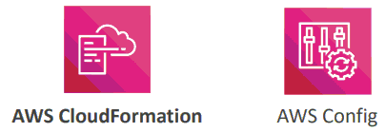
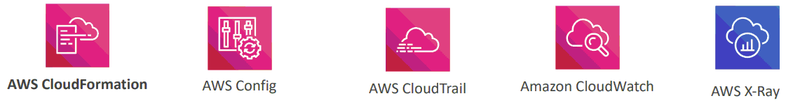
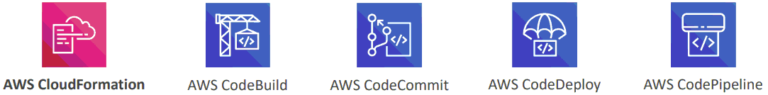
Well-Architected Framework
Prepare
Operate
Evolve

Slide 6
Well-Architected Framework
  Security
    Includes the ability to protect information, systems, and assets while delivering business value through risk assessments and mitigation strategies
    Design Principles
      Implement a strong identity foundation - Centralize privilege management and reduce (or even eliminate) reliance on long-term credentials - Principle of least privilege - IAM
      Enable traceability - Integrate logs and metrics with systems to automatically respond and take action
      Apply security at all layers - Like edge network, VPC, subnet, load balancer, every instance, operating system, and application
      Automate security best practices
      Keep people away from data - Reduce or eliminate the need for direct access or manual processing of data

Slide 7
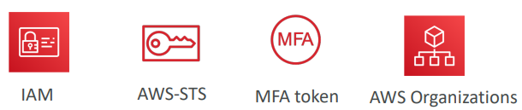
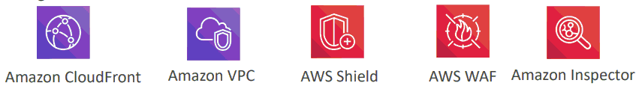
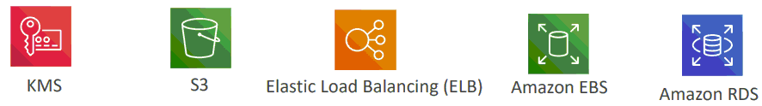
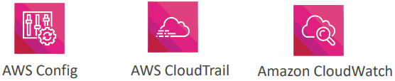

Well-Architected Framework
      Prepare for security events - Run incident response simulations and use tools with automation to increase your speed for detection, investigation, and recovery
Identity and Access Management
Infrastructure Protection
Data Protection
Detective Controls
Incident Response

Slide 8
Well-Architected Framework
  Reliability
    Ability of a system to recover from infrastructure or service disruptions, dynamically acquire computing resources to meet demand, and mitigate disruptions such as misconfigurations or transient network issues
    Design Principles
      Test recovery procedures - Use automation to simulate different failures or to recreate scenarios that led to failures before
      Automatically recover from failure - Anticipate and remediate failures before they occur
      Scale horizontally to increase aggregate system availability - Distribute requests across multiple, smaller resources to ensure that they don't share a common point of failure
      Stop guessing capacity - Maintain the optimal level to satisfy demand without over or under provisioning - Use Auto Scaling
      Manage change in automation - Use automation to make changes to infrastructure

Slide 9
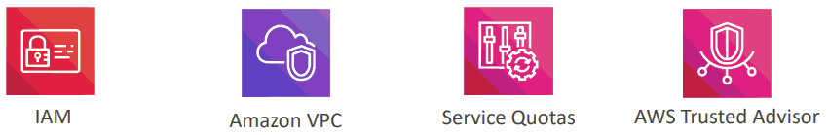
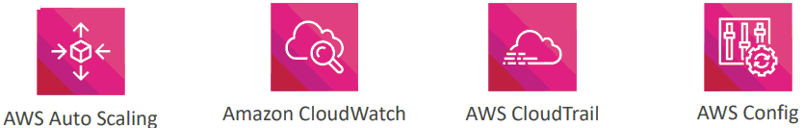
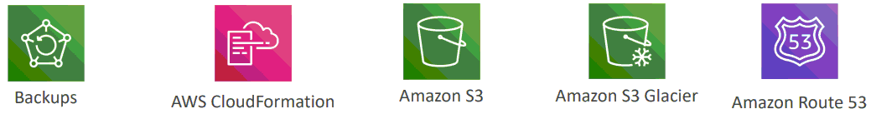
Well-Architected Framework
Foundations
Change Management
Failure Management

Slide 10
Well-Architected Framework
  Performance Efficiency
    Includes the ability to use computing resources efficiently to meet system requirements, and to maintain that efficiency as demand changes and technologies evolve
    Design Principles
      Democratize advanced technologies - Advance technologies become services and hence you can focus more on product development
      Go global in minutes - Easy deployment in multiple regions
      Use serverless architectures - Avoid burden of managing servers
      Experiment more often - Easy to carry out comparative testing

Slide 11
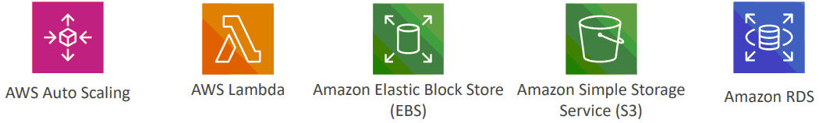

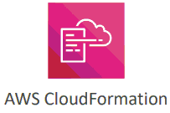
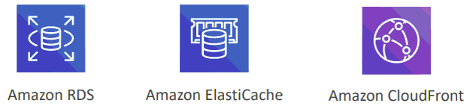
Well-Architected Framework
Selection
Monitoring
Review
Tradeoffs

Slide 12
Well-Architected Framework
  Cost Optimization
    Includes the ability to run systems to deliver business value at the lowest price point
    Design Principles
      Adopt a consumption mode - Pay only for what you use
      Measure overall efficiency - Use CloudWatch
      Stop spending money on data center operations - AWS does the infrastructure part and enables customer to focus on organization projects
      Analyze and attribute expenditure - Accurate identification of system usage and costs, helps measure return on investment (ROI) - Make sure to use tags
      Use managed and application level services to reduce cost of ownership – As managed services operate at cloud scale, they can offer a lower cost per

Slide 13
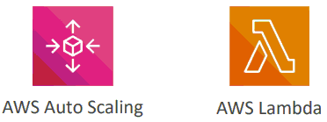

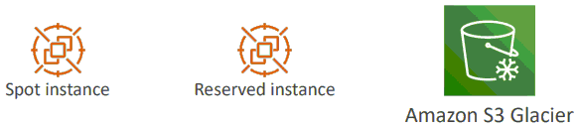
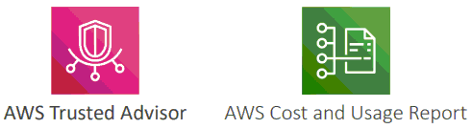
Well-Architected Framework
Expenditure Awareness
Matching supply and demand
Cost-Effective Resources
Optimizing Over Time

Slide 14
Well-Architected Framework
Demo
  https://www.youtube.com/watch?v=ZVunPiLvCu4

Slide 15
Q & A
Copyright © VTI Academy All Rights Reserved

